Slide 1
Alkalmazásfejlesztés
279525368
Nagyvállalati rendszerek fejlesztése és üzemeltetése DevOps alapokon | Major Balázs | 2022/02/21

Slide 2

Introduction - Balázs Major
Developer for 15 years
Focus on backend development
Nowadays practice in cloud-ready application
Chapter Lead in Magyar Telekom
Lead Developer in a developer team

Slide 3
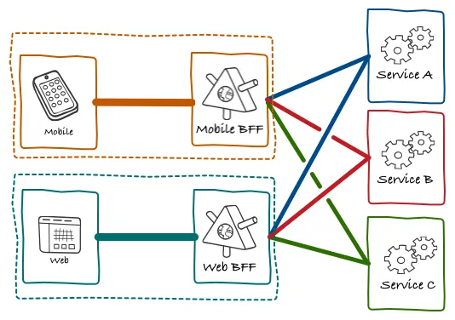
The development architecture
Front end: Mobile applications, Web applications, TV platform, etc.
Back end: Microservice based architecture
Technology: Spring based (Java) services
Language: Kotlin
Domain: Product, Consumer, etc.

Slide 4
Agenda
Software development
Refinement
Implementation
Testing & Integration
Task & Demo

Slide 5
Software development

Slide 6
The Software Development Lifecycle
Design
DevOps team connect into the Software Development Cycle in Design phase.
Low level design
Refinement
Implementation
Agile sprints
Review
Refinement
Testing & Integration
Testing levels

Slide 7
Design

Slide 8

Application design
Development team is responsible for finding the fit of new business requirements.
The well design tasks are essential for the daily work of the development team.
Refinement is the next step after successful application design phase.

Slide 9

Definition Of Ready (DOR)
Product Backlog items that can be Done by the Scrum Team within one Sprint are deemed ready for selection in a Sprint Planning event. They usually acquire this degree of transparency after refining activities.
Acceptance Criteria
Title and brief business description
Acceptance criteria
Non-functional and security requirements
High Level Design

Slide 10
Implementation

Slide 11
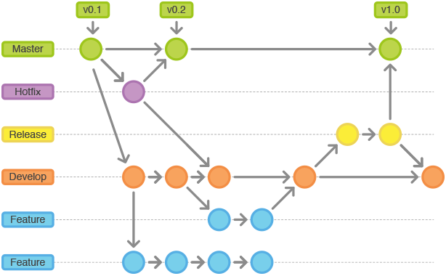
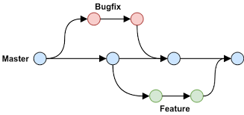
Branching strategy
GIT Flow
GitHub Flow
The chosen branching strategy depends on the used environments, level of testing and common understanding.

Slide 12
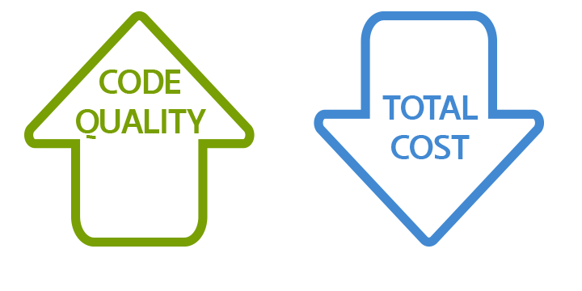
Software Quality
Goals
Clean code
Quality of code
Readability of code
Makes code maintenance easier
Tools
Static code analyzer – SonarQube
Code reviews & common principles
High test coverage

Slide 13
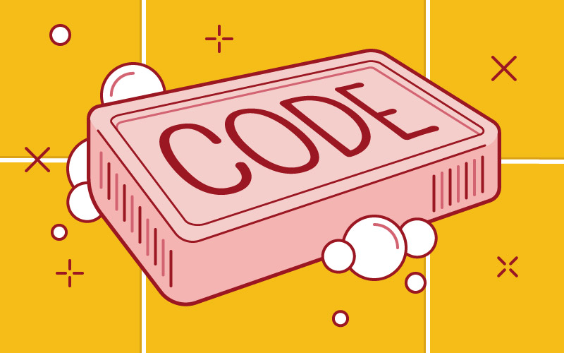
Clean code principles
Deep nesting – use functions instead
Comments – self-explanatory functions
Avoid large functions – separation
Code repetation
Meaningful names
Consistent verbs – get, set, create
Variables – camelCase
Classes – PascalCase
Constants – SNAKE_UPPER_CASE

Slide 14
Debugging tools

Slide 15
Debugging & tools
Bug: Unexpected problem with any software
DeBug: Steps to isolate source of bug.
Tools: Logging, Chrome DevTools, IDE Debug tools – IntelliJ, Visual Studio Code
Notes:
The ability to quickly and effectively find and resolve bugs in new and established systems is one of the most valuable engineering skills that you can develop. Since this skill enables the rapid development and maintenance of high-quality engineered systems, it is foundational for many technology companies, and is one of their most valued and sought-after skills. Nevertheless, this skill is rarely evaluated in coding interviews, and is often poorly understood and documented.
I have debugged and resolved many difficult problems in many different types of systems, including massively complex computer processors, multi-threaded servers and apps, and troubled individuals, families, and organizations. The optimal procedure for finding and fixing bugs is essentially the same across all domains. Surprisingly, many software engineers do not have a clear understanding of the process. I intend to address this deficit now. Here is my treatise on debugging.

Slide 16
Testing and integration

Slide 17
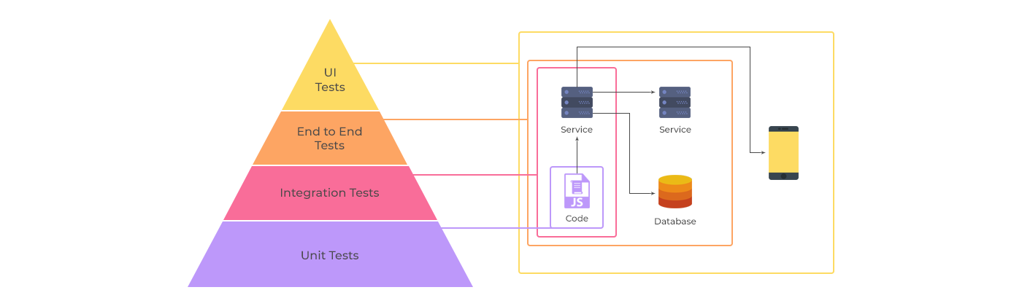
Testing pyramid
Unit Tests
Low level Integration Tests
Out of scope: End to End Tests, UI Tests

Slide 18
Unit testing & tools
Unit: smallest component of the system that can be tested
Standard structure of unit testing:
Given: Input for unit that given.
When: Call the unit with specified parameters.
Then: The result are tested for specified use case.
Built into CI/CD process, test automation process.
Tools: JUnit – Mockito

Slide 19
Low level Integration tests & tools
Testing service integration points with or without mocking.
Levels: component, integration test.
Can be run in CI/CD process.
Tools: Wiremock, Postman.

Slide 20

End-to-end test & tools
Complex test for business use cases.
Types:
UI test,
System test.
End-to-end tests are cannot be fit into CI/CD process.
Test automation process.
Tools:
UI Tests: Selenium,
Manual tests.

Slide 21
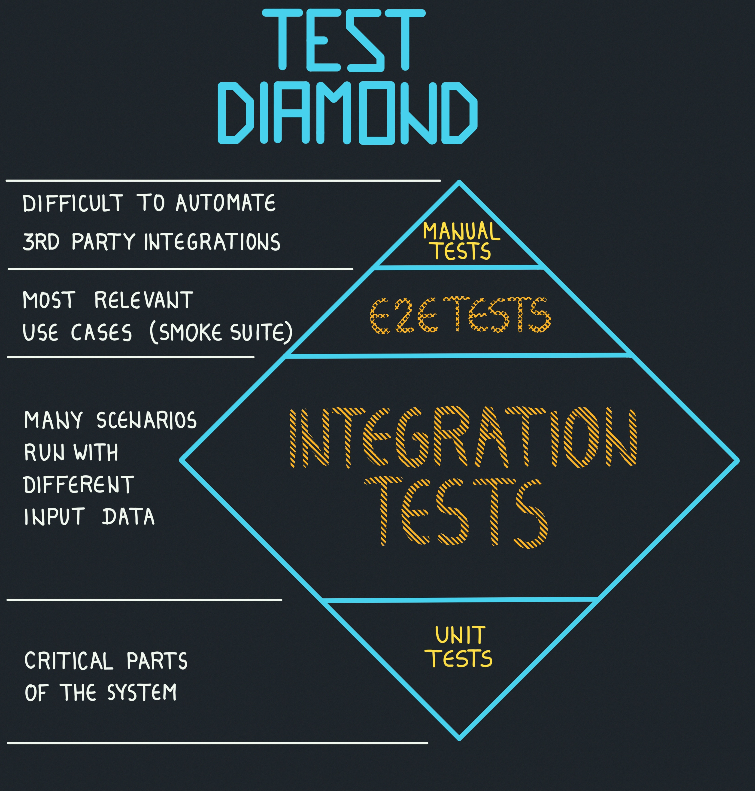
Testing diamond
New wave on microservice development: boundaries of application was changed
Focused into integrations tests on microservice based architectures
Advantages:
production like test cases,
less time is spent to mock,
can be run on CI like unit tests.
Disadvantages:
run slowly,
test size is bigger.

Slide 22
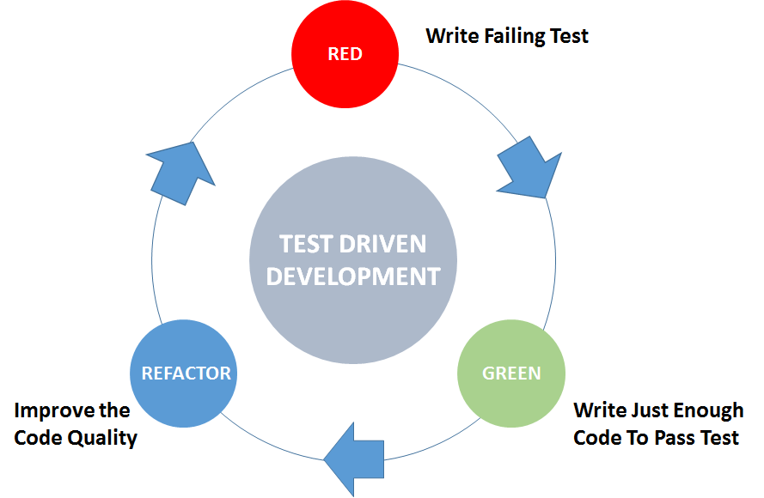
Test Driven Development (TDD)
Process
Testing first
Unit test + Low level integration test
Benefits
Higher software quality
Better code coverage
More understand how the application used
Disadvantages
Needed more time to introduce
Other mindset

Slide 23
CI/CD

Slide 24
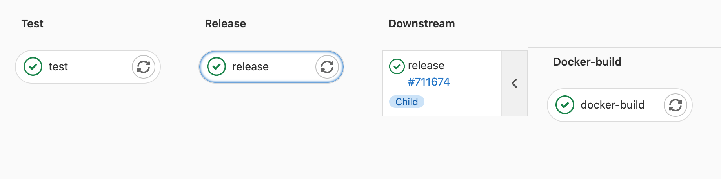
CI/CD - Part 1.
CI Stages
Test (style, static, coverage, semantic)
Release (semantic versioning)
Build (artifact, docker image)
public | Balázs Major | Alkalmazásfejlesztés

Slide 25
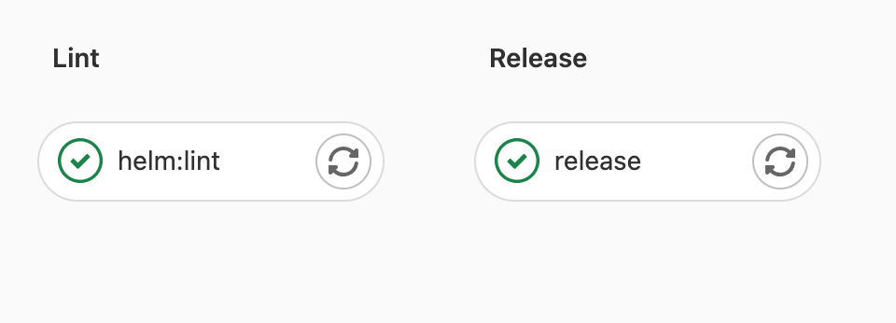
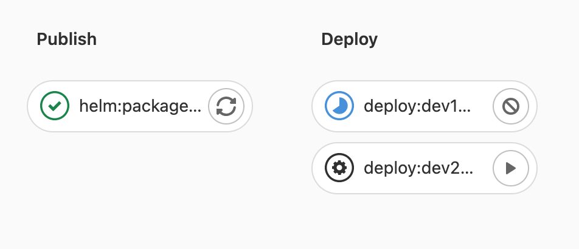
CI/CD - Part 2.
CD Stages
Lint (validate)
Release (semantic versioning)
Deploy (manual or automatic)
Test (manual or automatic)
public | Balázs Major | Alkalmazásfejlesztés

Slide 26
Task & Demo

Slide 27
Tasks
Create GitHub account and repository following on the next point described instruction.
Follow the next instructions to fork and code a Spring application -> GitHub.
Use different tests to ensure the right implementation.
Create merge request for your one college or me -> GitHub profile.

